Slide 1
Covid-19
Android Tracking System

Slide 2
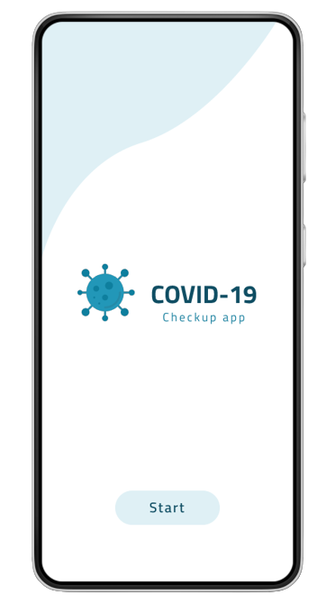
Duration: 20 min
Collage
CS
What is COVID-19?
History, Kinds

Slide 3
Team Members
احمد جمال ابوطالب (2019030007)
محمد ثروت محمدعبدالله (2019030150)
احمد صفوت محمد (2019030011)
محمد خالد ابوالحسن (2019030069)
محمد احمد سليمان (2019030063)
محمد احمد عواض عيد (2019030065)
محمد عبدالوهاب فتحي (2019030155)
عبدالرحمن محمدغنيمي (2019030139)
محمد كمال عبدالحميد (2019030156)
ابو العينين محمد (2019030112)
احمد صلاح عبد العاطي (2019030012)

Slide 4
Overview
A new virus called Coronavirus and hits the world and Cause of many deaths last 2 years, we developed an APP that telling the user if he has the virus , isolate himself or have nothing and suggest the nearest hospital in his area and some doctors who have high efficiency in coronavirus disease.
Objectives
Peoples want to know if they have the virus or not, in our project we developed an APP to android predict if you have the virus by asking you some question that showing to user if he has this disease or not and telling him to go to hospital with suggest some of hospital which is nearest by him, or telling him you should isolate yourself in home with suggest same doctors that have high efficiency in your case, or you have nothing and you should don’t worry about this

Slide 5
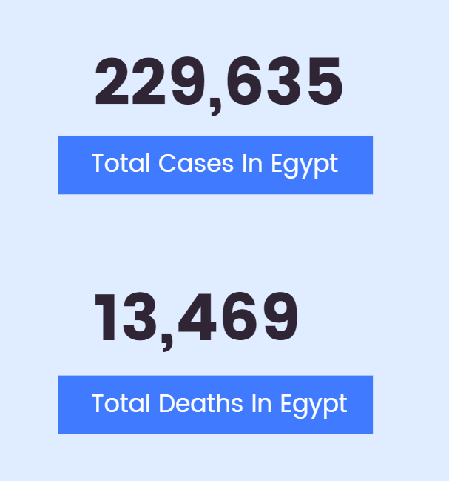
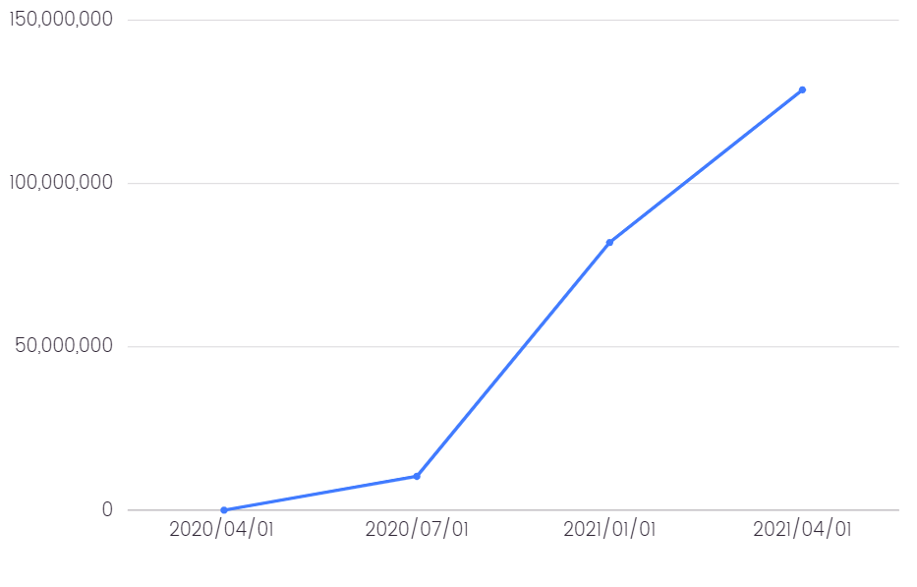
Statistics
Global Infliction

Slide 6
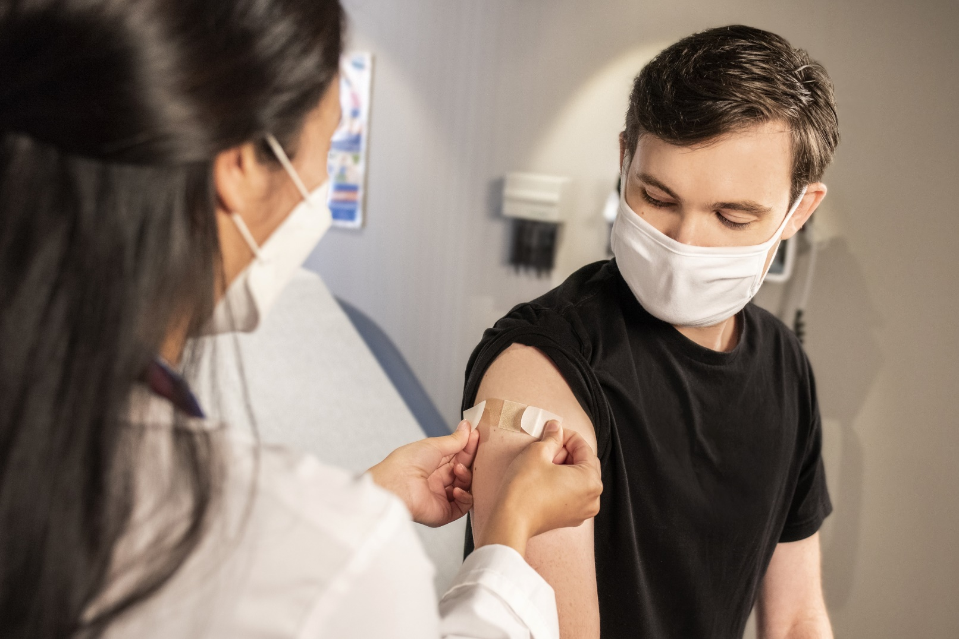
Hospitals Overcrowding Problem

